Slide 1
Native Git Commands
Commands you can use in GitBash

Slide 2
Clone Repo
Place new file into local repo
Remove file from local repo
Check status
Check diff between 2 versions of the same file
Commit changes
Push
Pull
Rollback
Revert

Slide 3
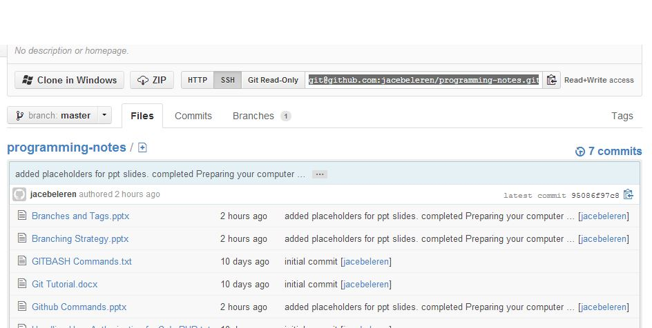
Clone Repo
In order to clone someone’s repository on GitHub, you’ll first need to get the SSH or HTTP link for the repository you want to clone.

Slide 4
Clone Repo
Once you’ve copied that, go to GitBash.
Navigate to your project space and type
git clone <link>
Fill in the <link> part with the link you copied and press Enter.
If you’ve set up the connection to use SSH keys, then GitBash will prompt you for you passphrase. If not, it will ask for your GitHub username and password.

Slide 5
Place new file into local repo
When you create a new file in your project folder, git will notice it, but will not keep track of it. In order to make git start tracking the file, you need to type:
git add <file name>
Just replace the <file name> part with your new file, and git will start tracking it.

Slide 6
Place new file into local repo
If you have multiple files that you want to add all at once, you can type
git add . or git add –a
Now git will add every single new file it locates within your project folder and start tracking their changes.

Slide 7
Remove file from local repo

Slide 8
Check status

Slide 9
Check diff between 2 versions of the same file

Slide 10
Commit changes

Slide 11
Push

Slide 12
Pull

Slide 13
Rollback

Slide 14
Revert

